Slide 1
Project Name : Telephone billing management with structure programming language (C/C++).
Team Member:
Al Ahad Sufian : 18192103056
Habibullah : 18192103080
Jahidul Islam : 18192103081
Dept. Of CSE BUBT
Supervised By : Saifur Rahman
Asst. professor
Dept. of CSE

Slide 2
Roadmap
1. INTRODUCTION
PROJECT OVERVIEW
2. SUPPORTING LITERATURES
SYSTEM SPECIFICATION
DATA FLOW DIAGRAM
PROJECT PLANNING AND SCHEDULING
INPUT AND OUTPUT SCREEN
DATABASE DESIGN
3.CONCLUTION

Slide 3
Introduction
The purpose of the project is to present the requirement of the Computerization of Telephone Billing System. The project thus calculates the telephone bills automatically. It does almost every work which is related to automatic telephone billing connection system via- new connection, customer record modification, viewing customer records & all works related to rate of bills, meter readings in addition to bill calculation and bill generation. “Telephone Billing System” is developed as per seeing the increasing requirement to speed up the work and incorporate a new work culture. Thus a new software has been proposed to reduce manual work, improving work efficiency, saving time and to provide greater flexibility and user-friendliness as the system previously followed was totally manual one with lots of errors.
Objective:
Information retrieval will become easy.
Maintenance of database as well as overall project will become easy.
Security measure will be adopted, by maintaining the login of username and the password.

Slide 4
SUPPORTING LITERATURES
SOFTWARE REQUIREMENT SPECIFICATION (SRS):
SRS (Software Requirement Specification) is a document that completely describes what the proposed should do, without describing how the software does it.
PURPOSE
PERFORMANCE REQUIREMENT
SOFTWARE QUALITY ATTRIBUTES
Maintainability
Portability
Flexibility

Slide 5
DATA FLOW DIAGRAM
CUSTOMER RECORDS
AND RATES
ADMINISTRATOR
GENERATED BILL
TELEPHONE
BILLING
SYSTEM
CUSTOMER

Slide 6
Straight forward diagram
start
Choices
Payment
Add records
List records
Modify records
Search records
Delete records
Processing works
End

Slide 7
PROJECT PLANNING AND SCHEDULING
GANTT CHART
Problem Statement
& Analysis
Feasibility Study
Logical & Concept
System Designing
Coding, Testing &
Documentation
Activities
1 Nov’19 10 Nov’19 20 Nov’19 30 Nov’19 10 Dec’19
Time (In Days)

Slide 8
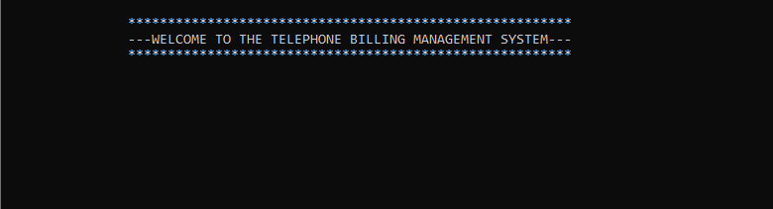
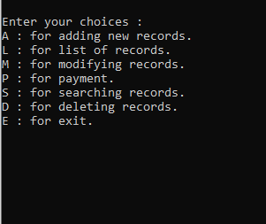
Input And Output Screen
First Choice List

Slide 9
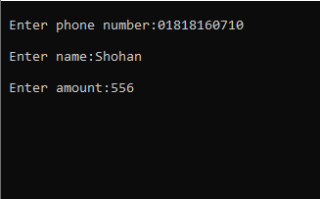

A: for adding new records.

Slide 10
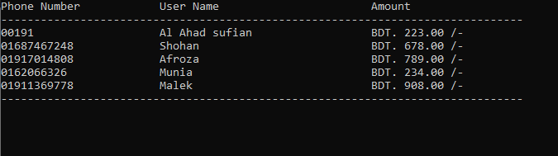

L: for list of records.
M: for modify records.

Slide 11
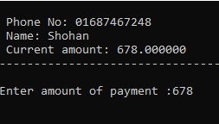
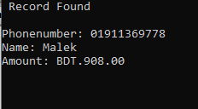
P: for payment.
S: for searching records.

Slide 12

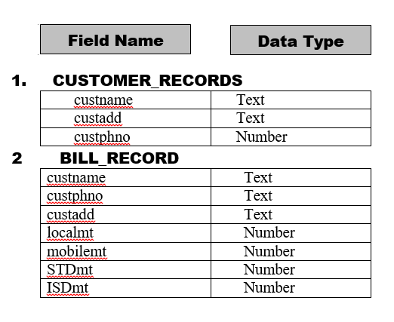
D: for deleting records.
Database Design

Slide 13
Conclusion
Software testing is a critical element of software quality assurance and represents the ultimate reviews of specification, design and coding. Testing presents an interesting anomaly of the software. During earlier definition and development phases, it was attempted to build software from abstract concept to a tangible implementation.
The testing phase involves the testing of the developed system using various set data. Presentation of test data plays a vital role in system testing. After preparing the test data the system under study was tested using test data. While testing the system by using test data errors were found and corrected. A series of tests were performed for the proposed system before the system was ready for implementation. The various types of testing done on the system are:
Unit Testing
Integration Testing
Validation Testing
User Acceptance Testing
System Testing

Slide 14
SCOPE FOR FURTHER IMPROVEMENT
Our system is not online so further it can be improved.
The security is limited so some additional arrangement could be made to provide more security to the system.
There is no provision of complain handling so further it can be added.

Slide 15
End of Presentation!
Thank You Sir for your
Attention

